Slide 1

Extruder Division
FERENTINO TYRE CORPORATION (Pvt.) Ltd.
Prepared by S S Lankageeganage

Slide 2
INTRODUCTION
Extruder process is manufacture shaped solid rubber components used to build tires treads and side walls. This profile output is continuously.
Duplex extruder is, this type of extruder machine has extruders with different diameters. Such as 150mm,200mm. That’s mean it has 2 inputs (rubber feeding).
Triplex extruder is this type of extruder machine has 3 extruders with different diameters. Such as 90mm,120mm,200mm. (3 input rubber feeding conveyers.)
There are 2 types of extruders, hot feed and cold feed. As this name blended heated compound feeding is hot feed. Rubber feeding with ambient temp. is cold feed. Ferentino has cold feeding machine(Duplex/Triplex).

Slide 3
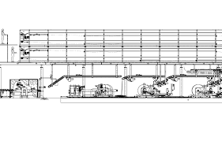
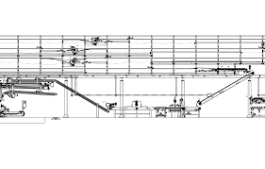
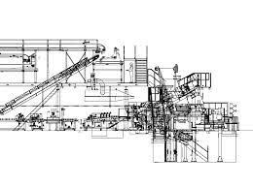
Triplex Extruder
7
7
7
1
8
6
12
11
10
9
5
4
3
2
Troester machine
Notes:
Here im going to explain about triplex extruder whole ppt contains abouts triplex

Slide 4
Triplex main areas
Extruder area
Head area
Take away conveyor area
Linear scale area
Cushion calendar area
Inclined conveyor area
Cooling line
Declined conveyor
Skiver cutter area
Booking scale area
Booking area
Winding area

Slide 5
In ferrentino, triplex extruder mainly used for extruding PCR tyre treads and sidewall. Because PCR tread consist 3 compound and Side walls consist 2 compound.
Machine operator has to maintain initial width and weight by adjusting RPM of the extruder and line speed according to the specification which was given by technical department.
This machine almost 50m long, it has long 2 stage cooling conveyor area.
Production quality is basically depending on machine specification because some parameters directly affecting by machine specification such as width, shrinkage, temperature…..etc.
The triplex powered by 3 source of powers,
Electrical power
Hydraulic power
Pneumatic power

Slide 6
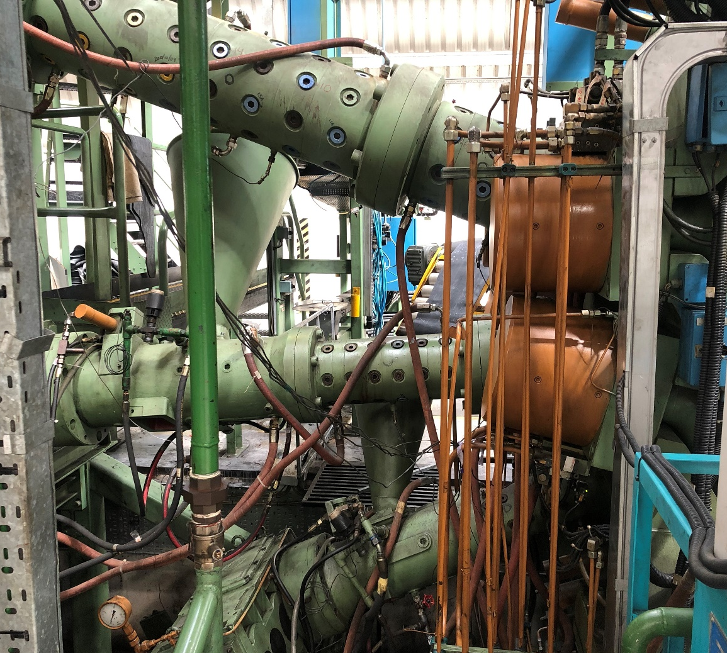
1.Extruder Area
There are 3 extruders in this particular area such as 90mm, 120mm, 200mm diameters extruders.
200mm
120mm
90mm

Slide 7
There are main component of the Extruder area.
Extruder barrels and pins
Extruder screw
Feeding conveyors
Temperature control unit (TCU)

Slide 8
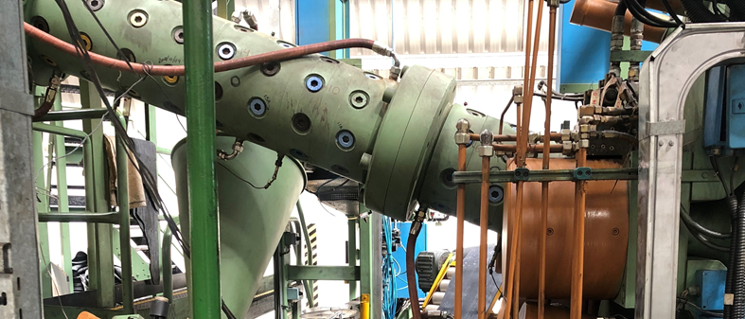
1.1 Extruder Barrels and Pins
Each extruder machine has 2 barrels and some number of pins
Pins are using for mixing compound well, when compound mixing it generates heat around pin.
By configuration, these pins we can maintain temperature deployment.
Barrel L:D ratio is, L:D ratio = Barrel length
diameter
Pin
Barrel 1
Barrel 2

Slide 9
200mm extruder,
Barrel 1 has 48 pins
Barrel 2 has 16 pins
L:D ratio is 16:1
120mm extruder,
Barrel 1 has 30 pins
Barrel 2 has 15 pins
L:D ratio is 16:1
90mm extruder,
Barrel 1 has 36 pins
Barrel 2 has no pins
L:D ratio is 16:1

Slide 10
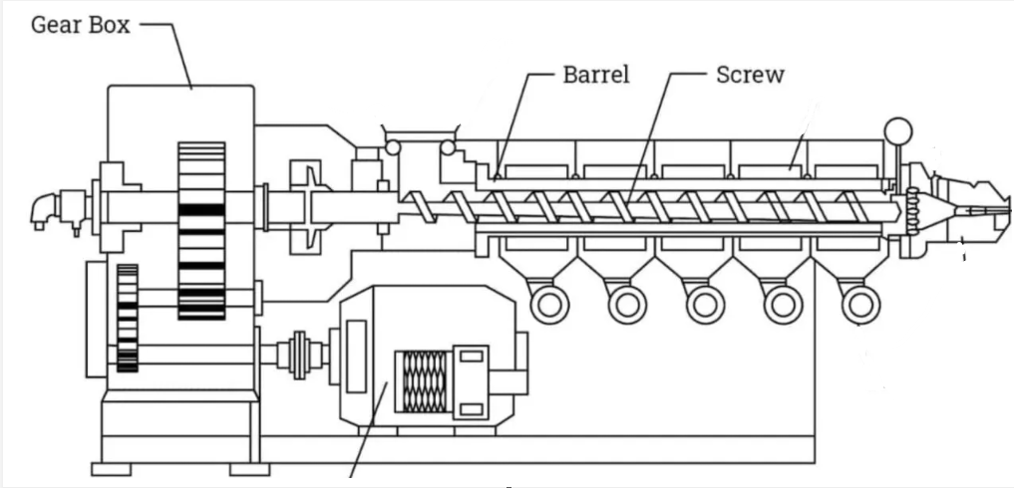
1.2 Extruder Screw
Each extruders have screws inside the barrel which is mixing rubber compound and feed forward.
Screw is connected to the gear box and gear box connect to the high-capacity motor.
Each extruder has different capacity motors.
Gear box used to reduce shaft speed and increase the torque

Slide 11
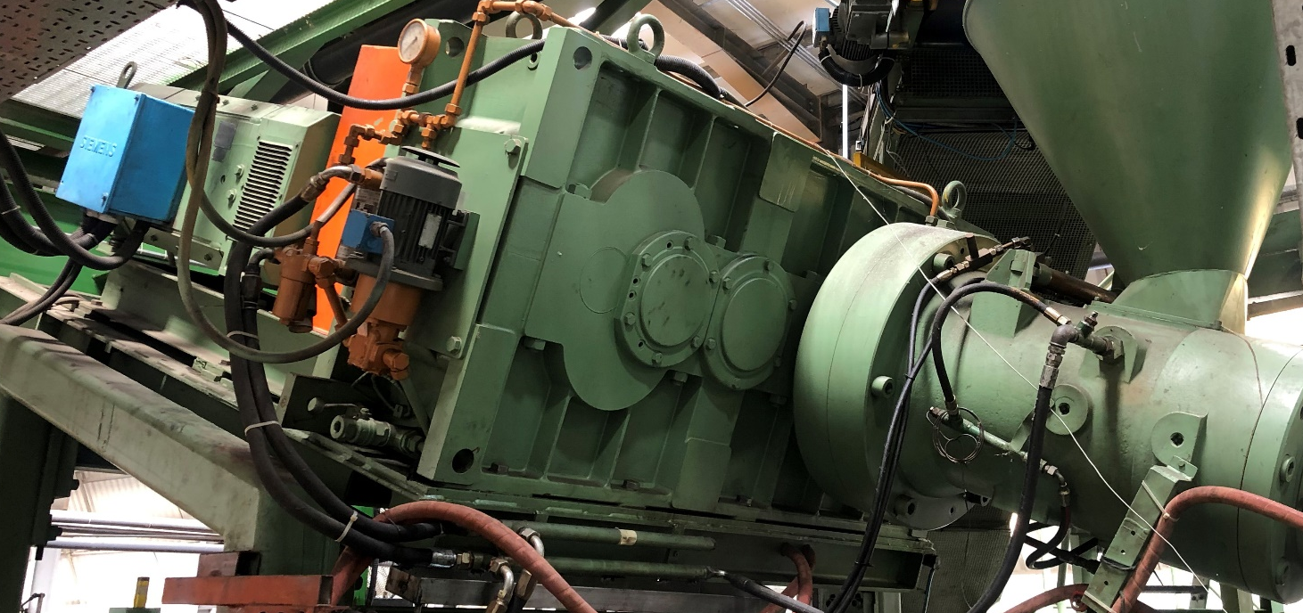
200mm extruder screw connected to the 316kW DC motor and its maximum speed is 35rpm.
120mm extruder screw connected to the 108kW DC motor and its maximum speed is 45rpm.
90mm extruder screw connected to the 58.5kW DC motor and its maximum speed is 65rpm.
Gear box
Main motor

Slide 12
1.3 Feeding conveyors
Feeding conveyors are located at each extruder barrel. Its one end has hopper and other end is feeding final compound sheet.
Hopper is opening where the feeding rubber sheet to the screw.
Hopper shaped like conic; it will help for feed rubber compound without breaking.
These feeding conveyors mainly contain 1.5kW AC motor, metal detector and pneumatic pump.
Metal detector has metal detecting sensor for checking whether feeding compound has metal particles.
Pneumatic piston pump using for bend the end of the conveyor.

Slide 13
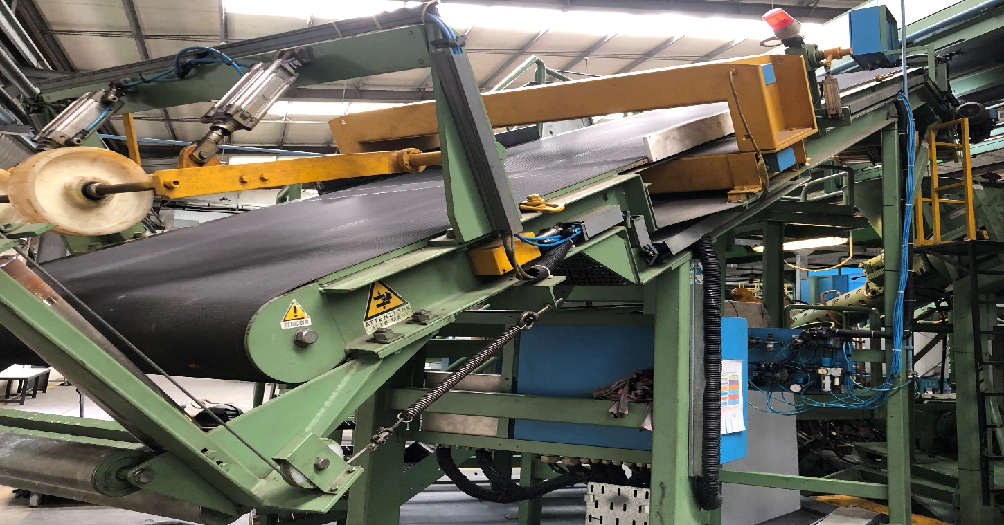

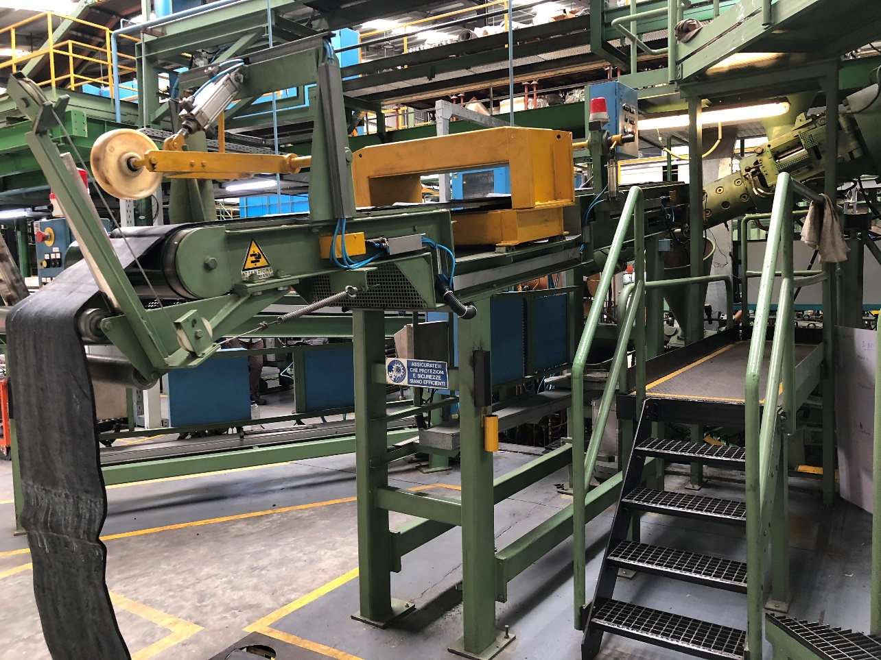
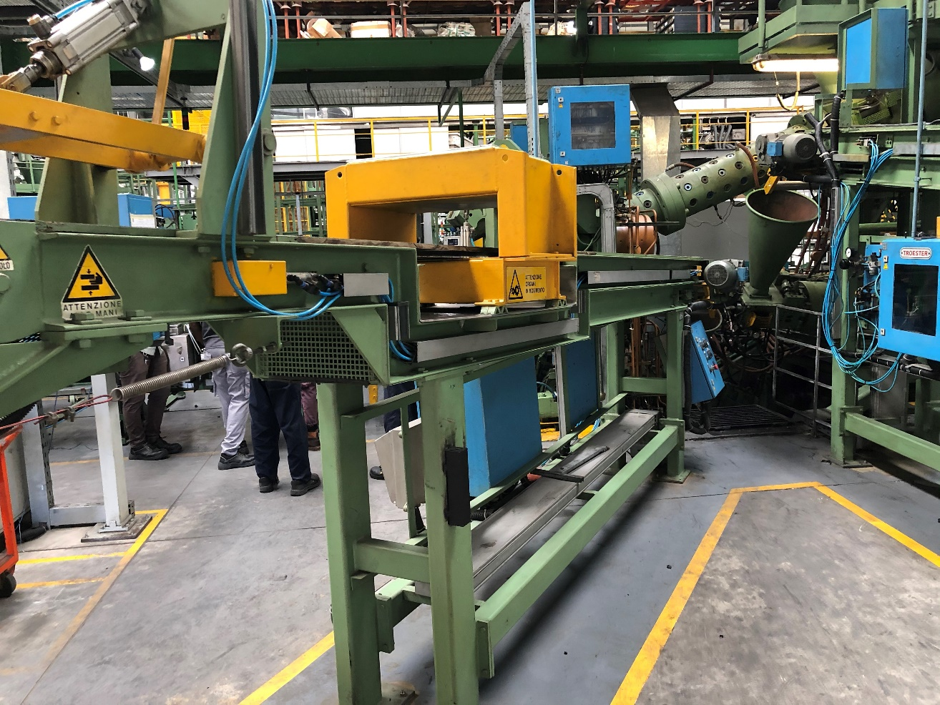
Metal detector
Compound sheet feed direction
Hopper
200mm feeding line width-900mm
120mm feeding line width-500mm
90mm feeding line width-300mm

Slide 14
1.4 TCU(Temperature control unit)
TCU is the unit which was implement for maintain temperature of some areas such as barrels, screw and head.
Method is using hot and normal water circulation around those areas to keep constant temperature value.
Each area has inlet and outlet water valve. Ex- barrel 1 has inlet and outlet valve.
When temperature is increasing normal water flow through related area and cool down that area.
When temperature is decreasing hot water flow through related area and heat up that area.
Water is heating by resistance coil.
Recommend extruded rubber temperature should be 115 C.
Temperature is measuring by using thermocouple(Fe-CuNi), the range is 0-300 C can be measured.
Water circulation pumping pressure is 4bar.

Slide 15
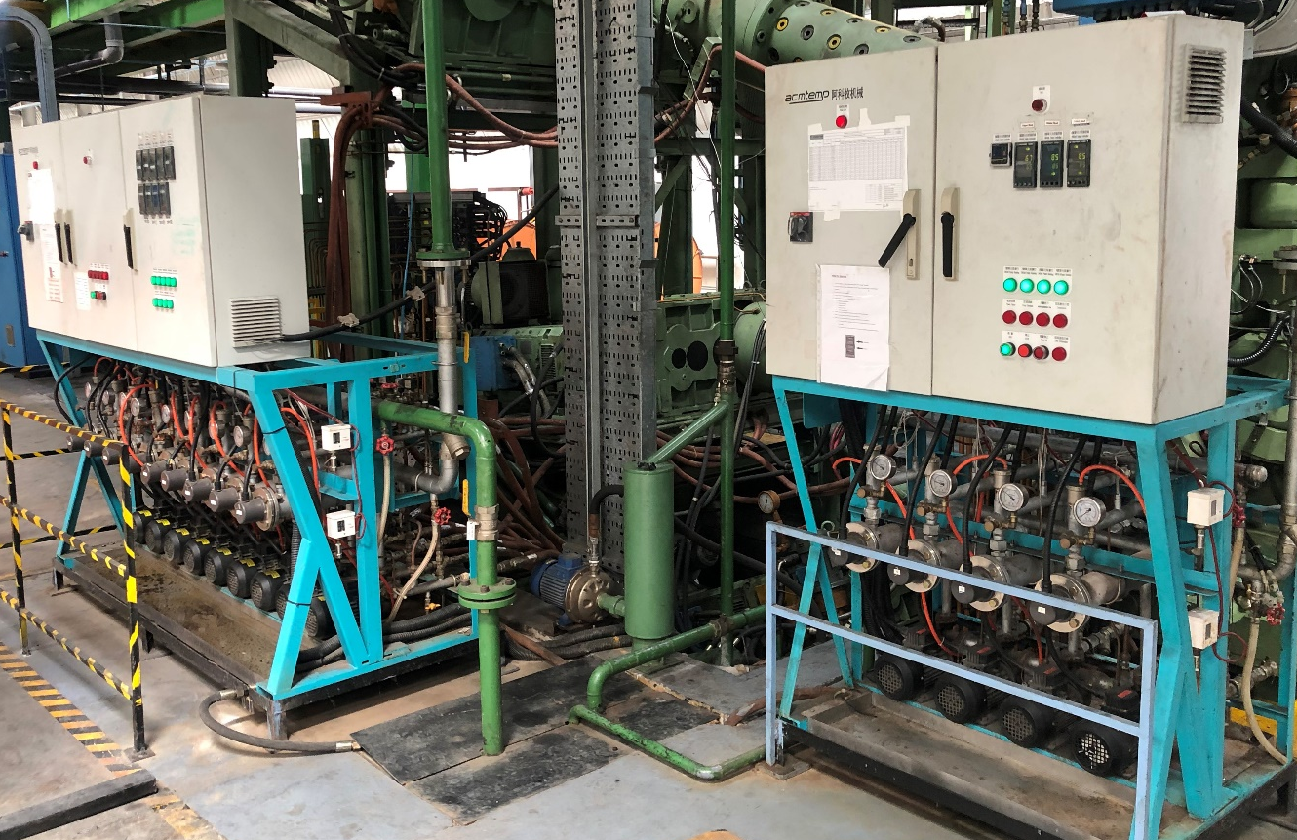
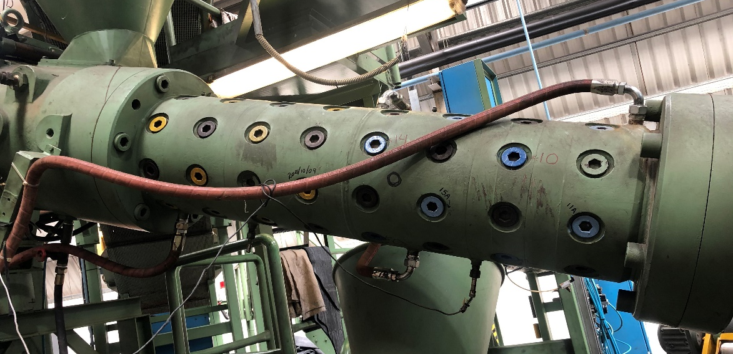
TCU
Outlet
Inlet and outlet different recommended value is,
5 C .
Inlet

Slide 16
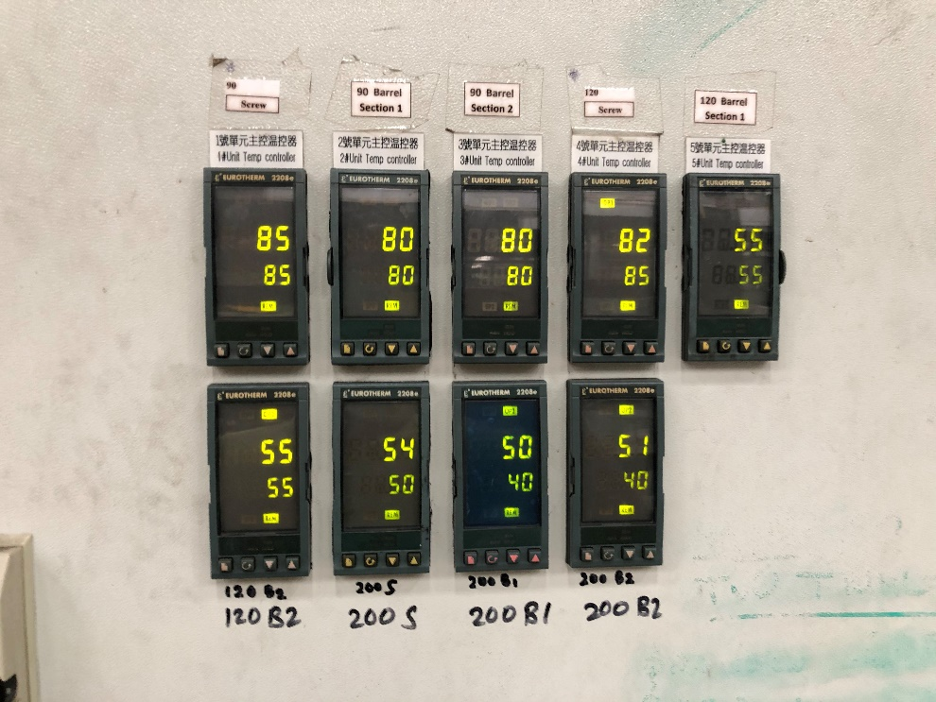
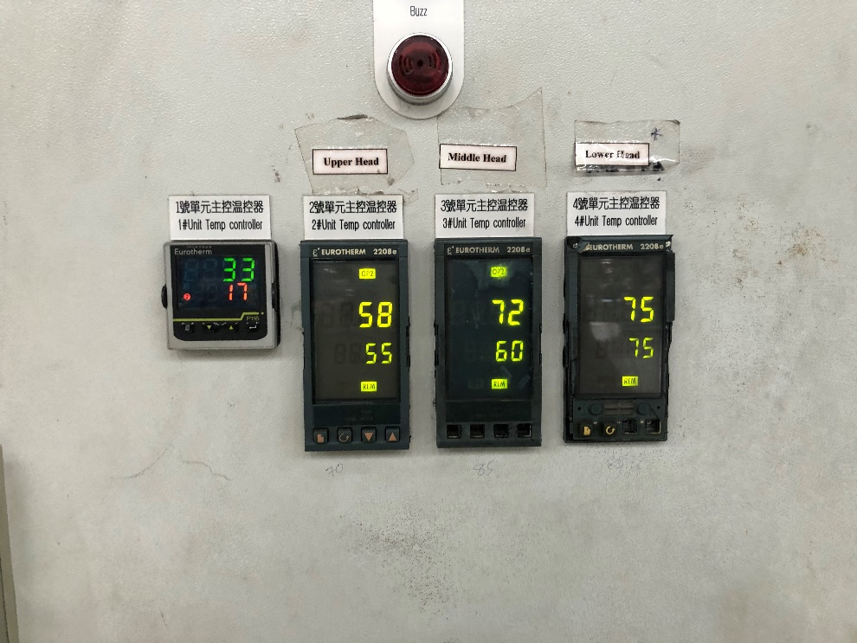
Temperature zones and areas
Temperatures should be set by machine operator before 10-15min starting to production.
Temperatures must set as specification related to the production.
1
2
3
4
5
6
7
8
9
Upper head
Middle head
Lower head
90mm screw
90mm barrel 1
90mm barrel 2
120mm screw
120mm barrel 1
120mm barrel 2
200mm screw
200mm barrel 1
200mm barrel 2

Slide 17
2. Head Area
Above 3 extruders connected to the same head. The whole head divided in to 3 parts,
Upper Head(200mm connected)
Middle Head(120mm connected)
Lower Head(90mm connected)
Head is working as nozzle of the extrusion procedure therefor production output dimension and shape got by head area because insert, performer and Die fixed in the front of the head.
Head part can be opening by 3 parts, these parts are too heavy therefore hydraulic powered piston will use for opening and clamping cassette.

Slide 18
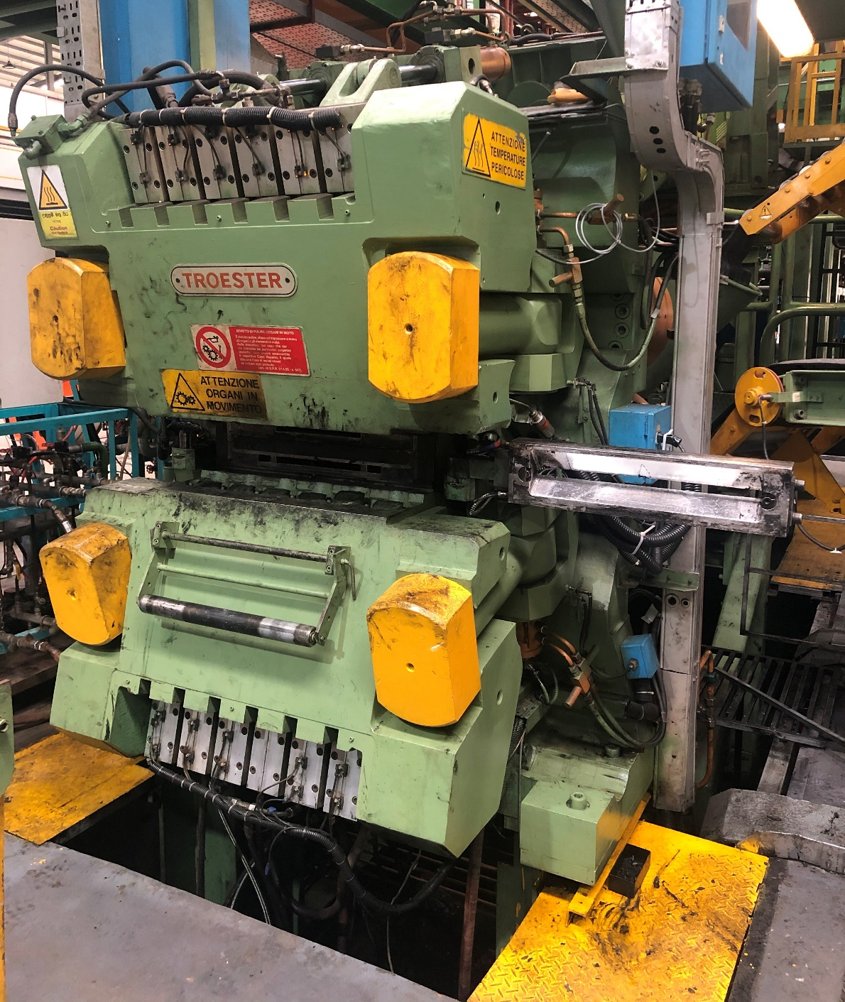
Upper head
Middle head
Clamp
Lower head
cassette

Slide 19
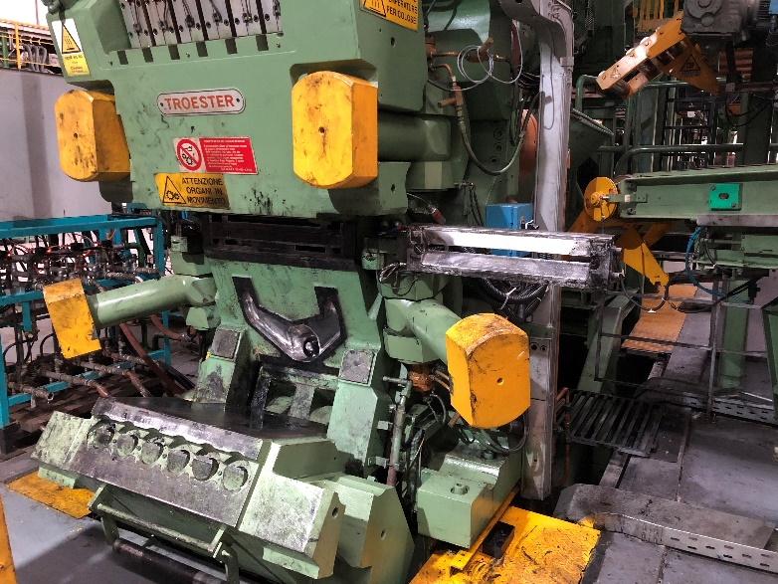
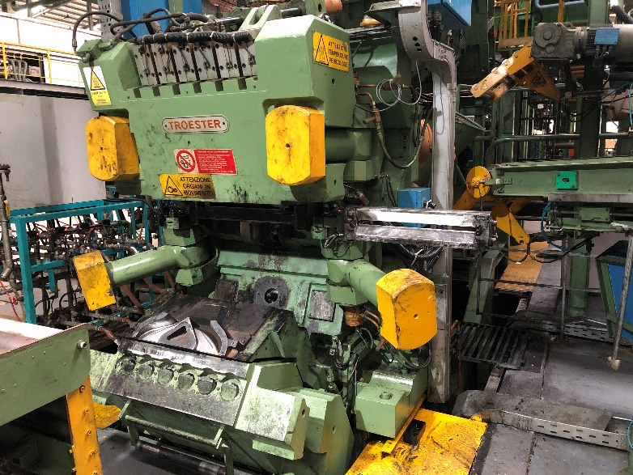
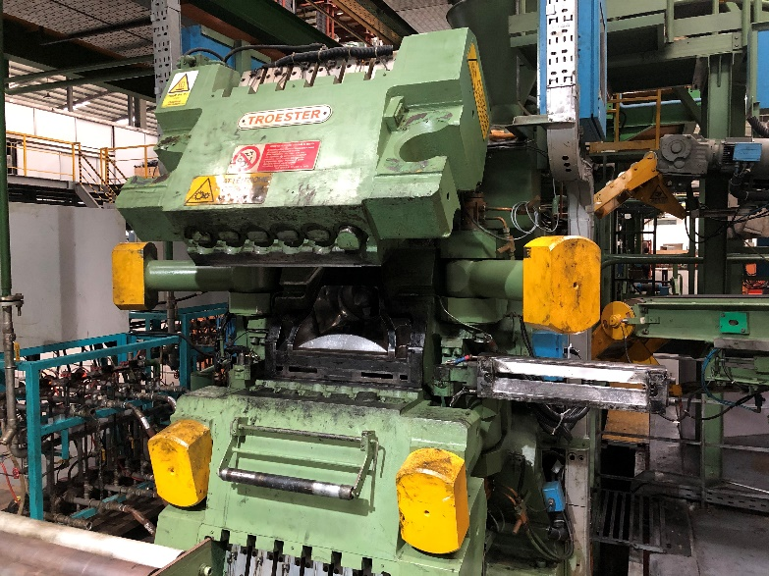
Head opening Stages

Slide 20
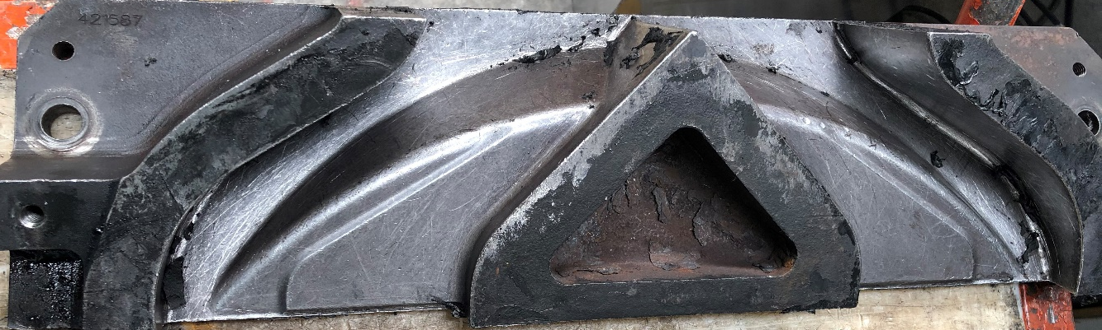
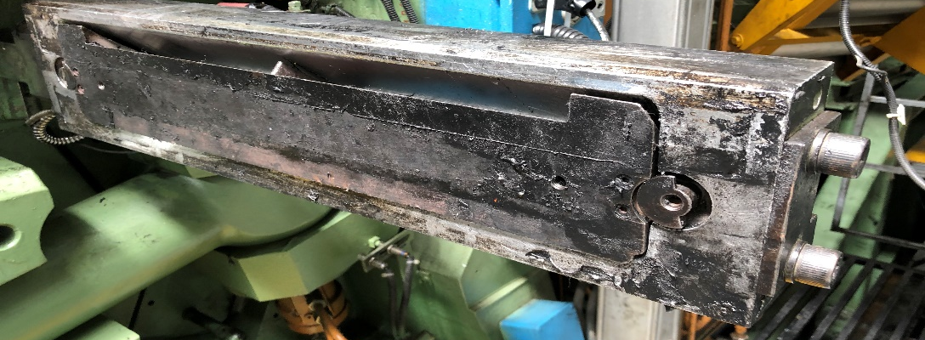
Head nozzle components
Insert :- Softness rubber will feed to the performer with high flow rate because insert reduce cross-section area and increase flow rate of soft rubber. It will be different by tyre type.
Performer :- soft rubber will directed by performer, rubber profile will get cross-sectional content as requirement. There are performers changing by tyre sizes.
cassette
Preformer

Slide 21
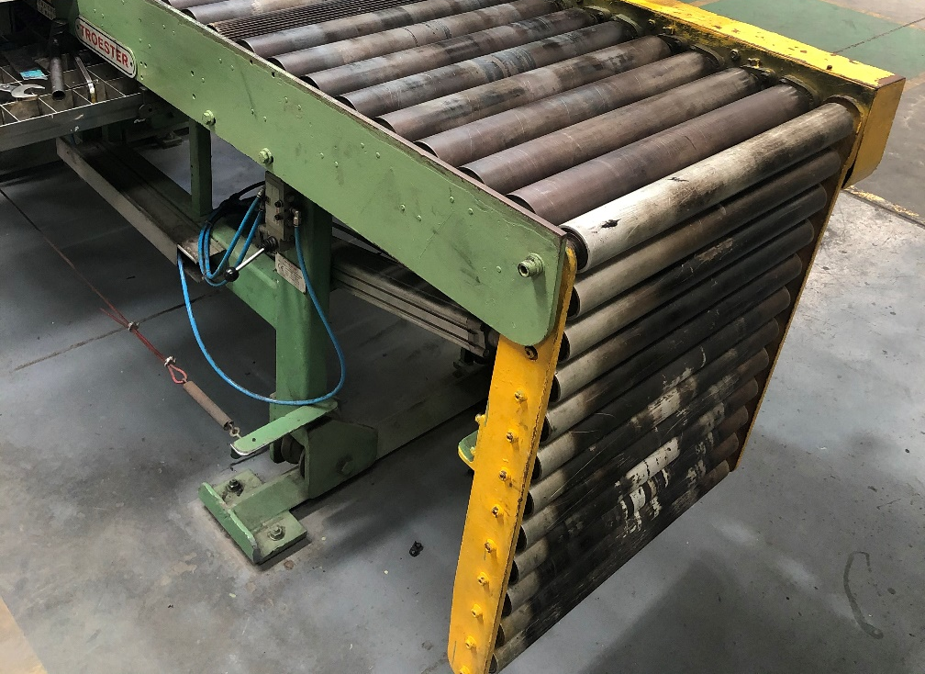
3.Take away conveyor
There is several parts for different purposes
Foldable conveyor
Shrinkage conveyor 1
Shrinkage conveyor 2
Shrinkage conveyor 3
Beginning of the takeaway conveyor line, there is foldable for accessing easily to head operation. It is folding by pneumatic piston
Foldable conveyor width- 600mm
No. of Rolls- 12
Length of the conveyor- 800mm
Height from the floor is 1350mm.

Slide 22
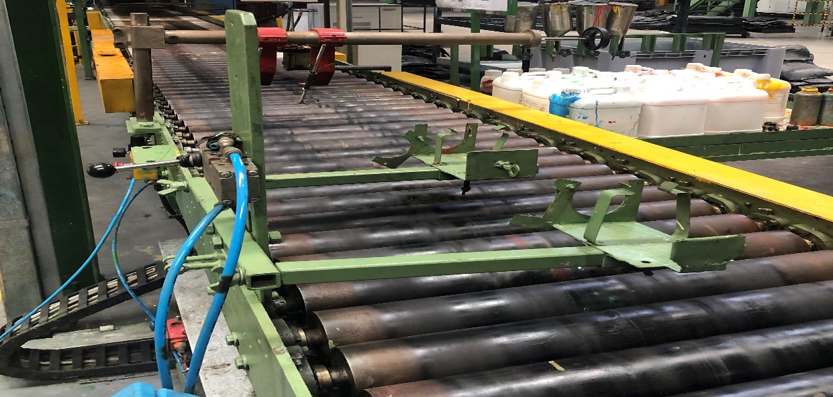
A roll dimensions
Shrinkage conveyor:-
There are 3 stage of shrinkage conveyors, those conveyors has 3 different velocities(Line speed). By adjusting conveyor speeds the extruded product width can be set as spec. Normally triplex has width increasing conveyors that’s mean shrinkage speed lower than line speed.
80.2mm
600mm
Shrinkage 3
Shrinkage 2
Shrinkage 1

Slide 23
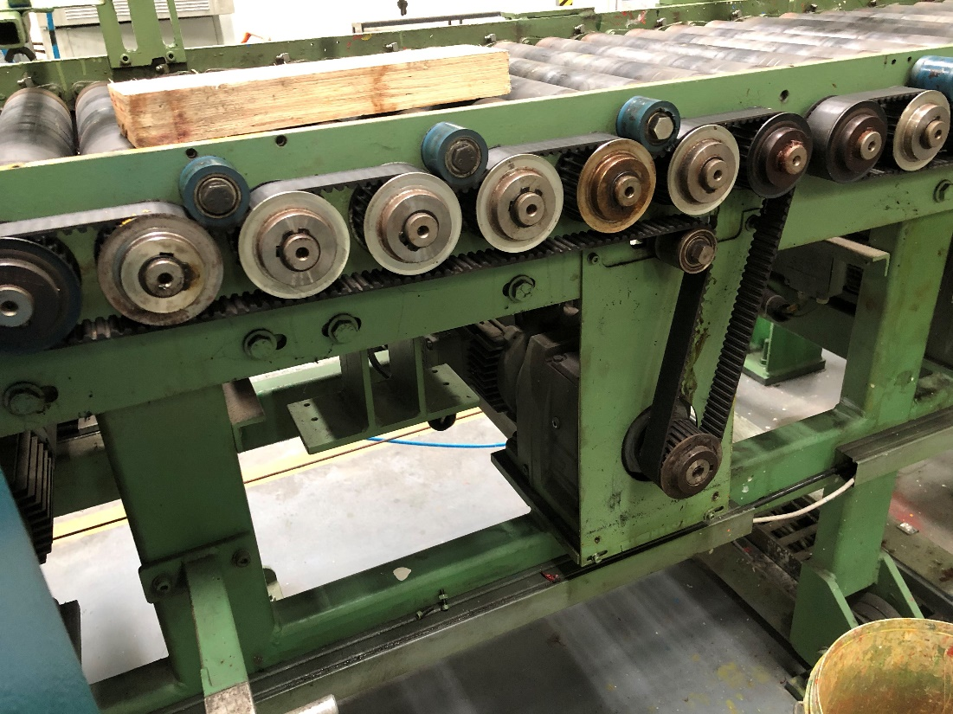
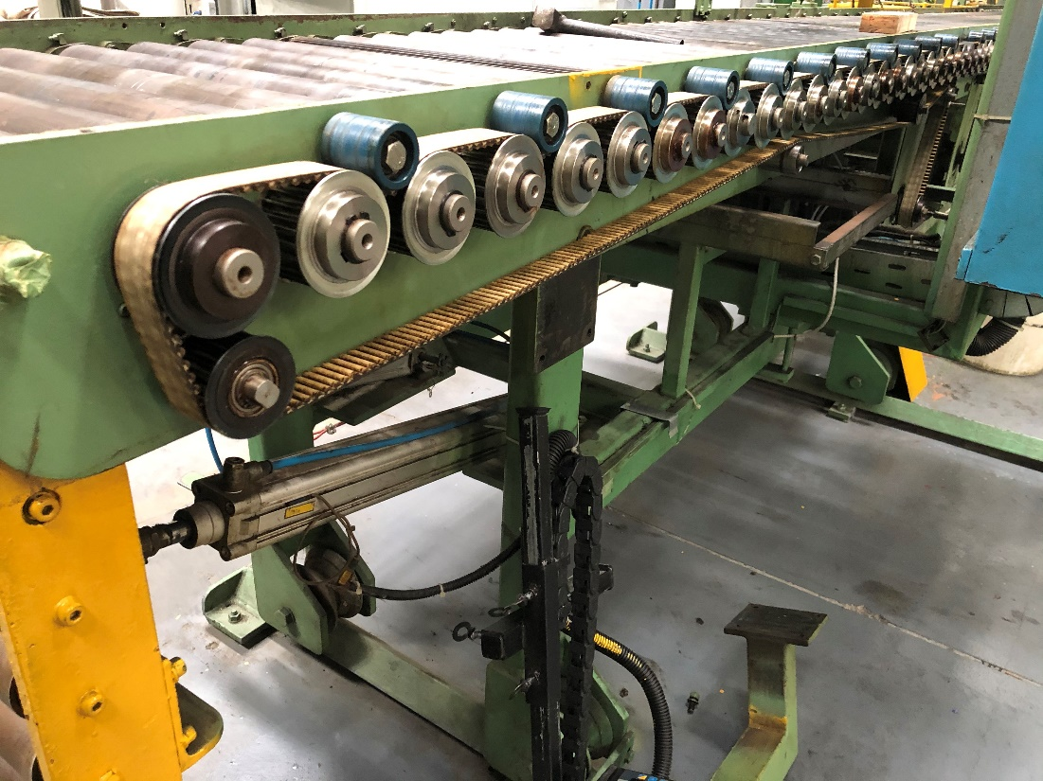
Line speed >Shrinkage 1 speed > Shrinkage 2 speed > Shrinkage 3 speed
Shrinkage conveyors width is also 600mm and it consists 58 rolls until linear scale.
Each Shrinkage conveyor has 1.1kW AC motors, Those are working on different RPM.
Rollers are connecting each other by rack, every rollers end have pinion.
Pinion
Rack
A motor

Slide 24
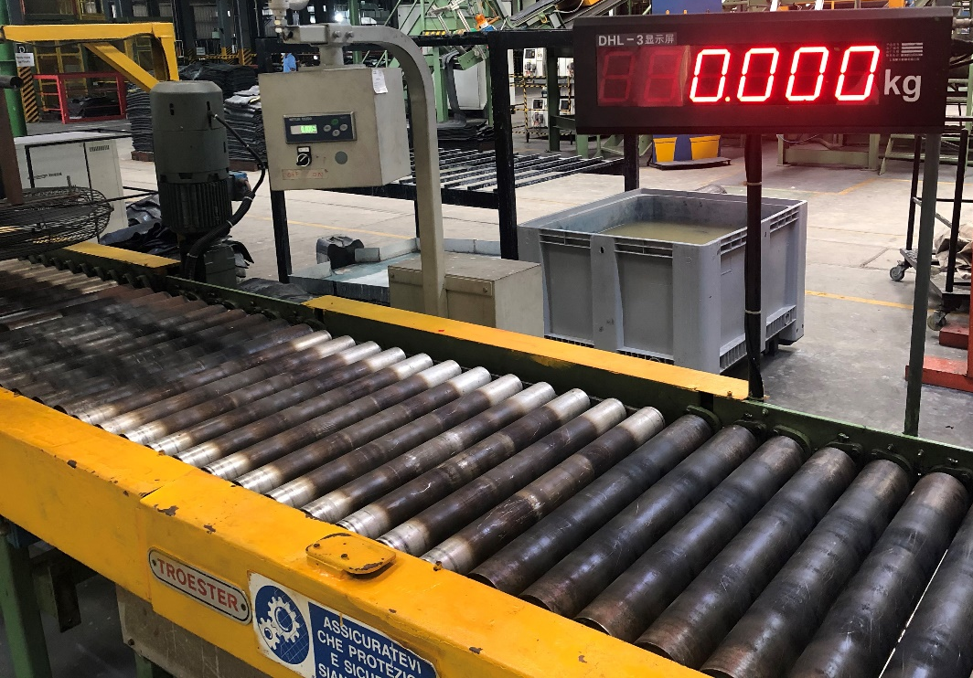
4.Linear Scale
Linear scale located after shrinkage conveyors for measuring initial weight of the product. Machine operator should keep the initial weight range as specification given by technical department.
This unit has sensor called loadcell, It converts an input mechanical force such as load, weight into another physical variable, in this case, into an electrical output signal that can be measured.
This unit can be measure up to 10kg and accuracy in 3 decimal points.(0.001)
600mm
500mm

Slide 25
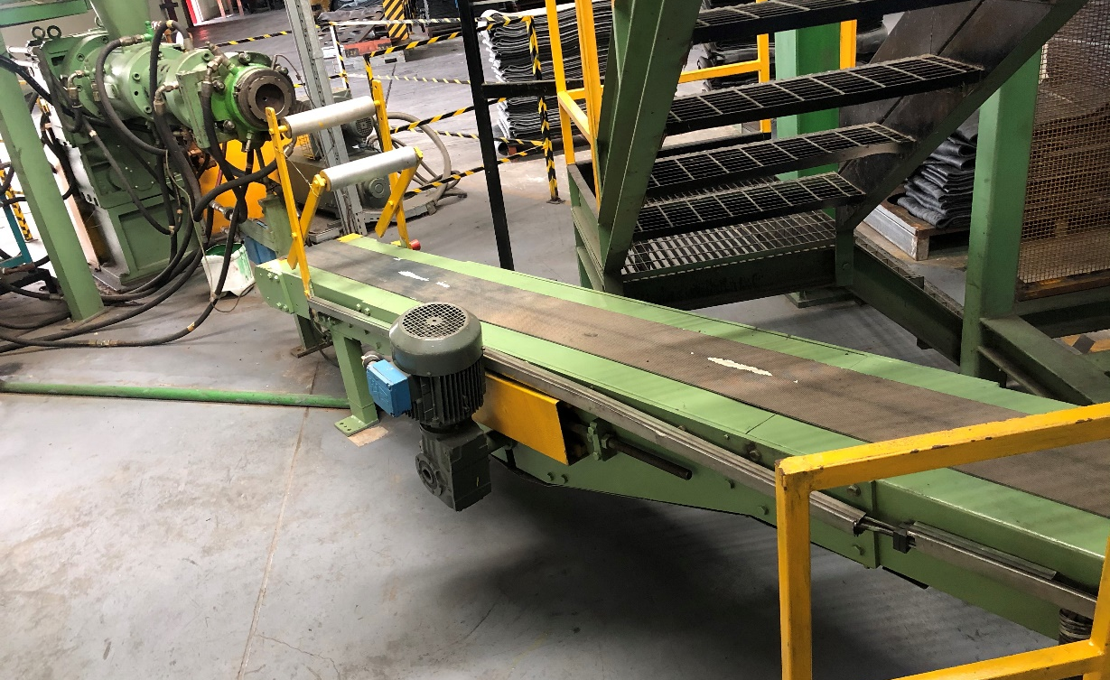
5.Cushion calendar area
Cushion calendar is using for apply cushion layer to tread production. Because tread needs to have enough tackiness past for green tire building.
It has external extruder for extruding cushion compound, and it has two roll mill.
Cushion extruder diameter- 90mm
L:D ratio- 16:1
Screw motor capacity- 53.5kW DC
Number of pins-36
Motor max rpm- 55rpm
Conveyor belt width-300mm
Conveyor motor – 1.1kW AC
Cushion extruder
Cushion conveyor

Slide 26
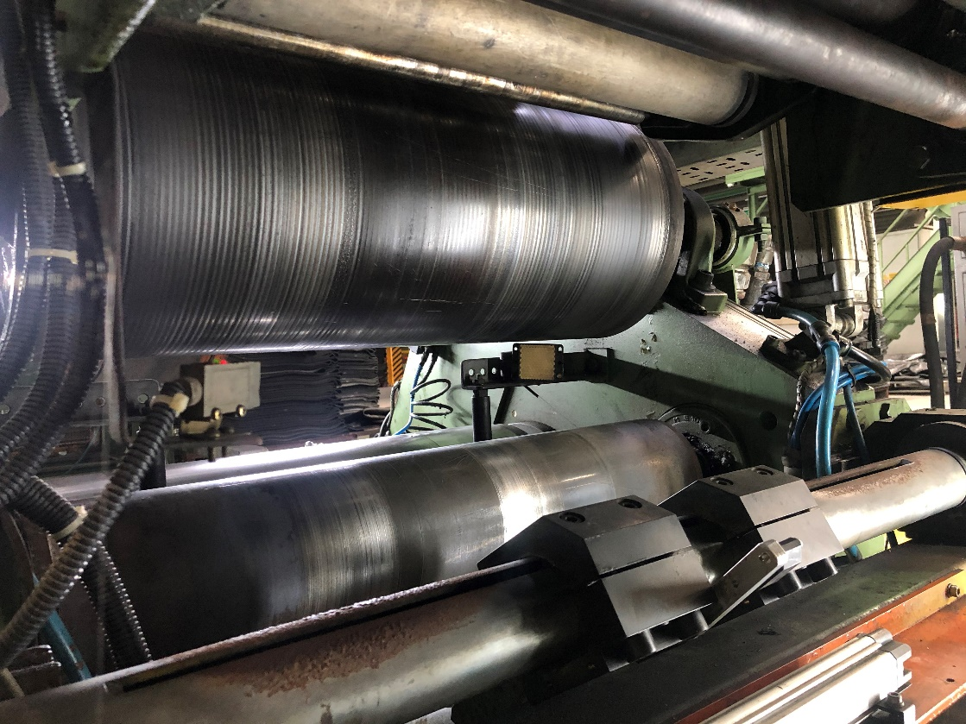
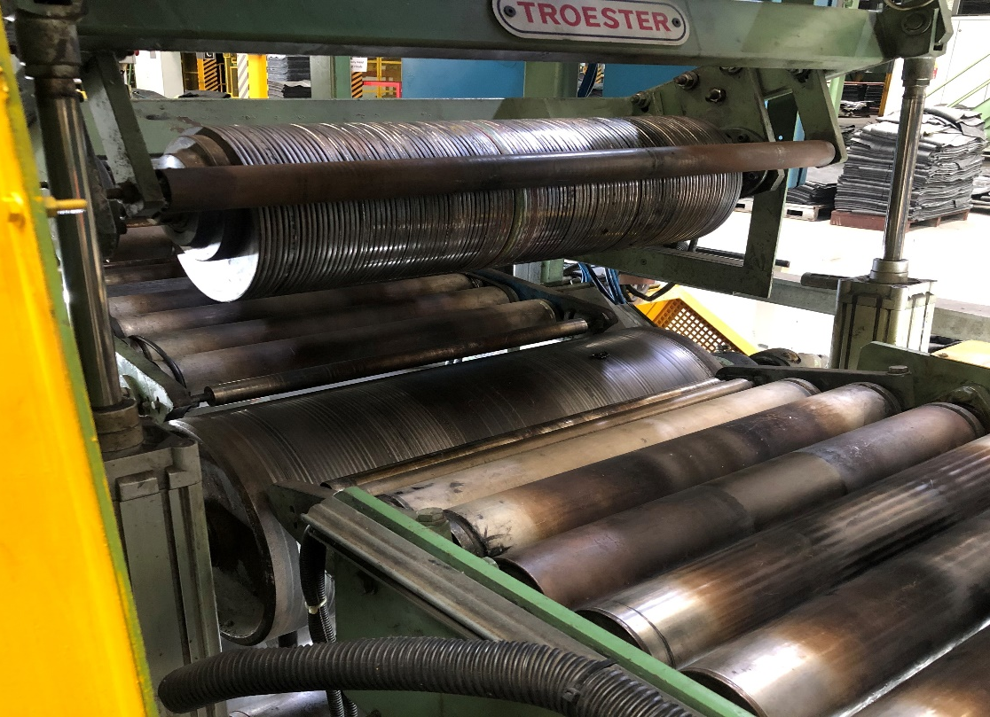
Cushion apply roll
This place is located under the conveyor.
By adjusting 2 roll mill can change cushion gauge.
Normally PCR tread using 0.5mm cushion gauge, 2/3 tread 0.6mm and TBB tread 0.9mm.
Mill motor capacity is 33.3kW DC
Max cushion 600mm width can be apply.
2 Roll mill
Knife cutter
Cushion apply roll where the cushion apply with base of the tread extrusion.
Disc cutter roller give thrust from the top of the tread for tack with cushion well. But it doesn’t harm tread cross-section dimensions.
There are 62 conveyor rolls from after liner scale to cushion calender.
Disc cut roller
Cushion apply roll

Slide 27
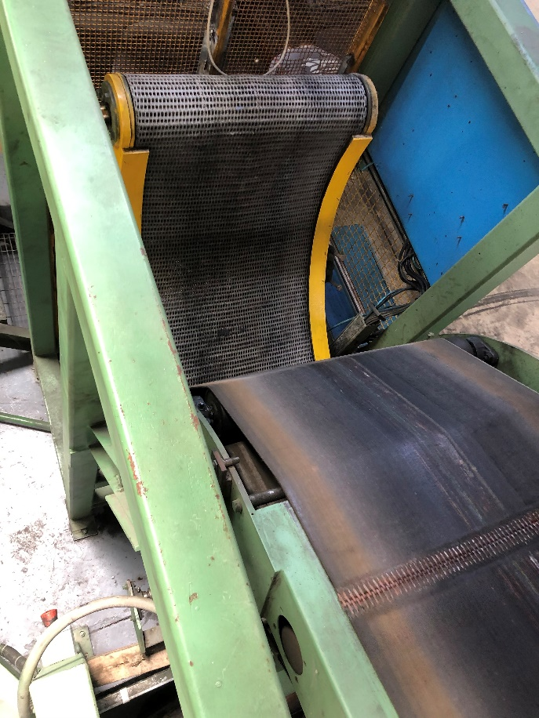
6. Incline conveyor
Inclined conveyor is taking continues production to upstairs cooling conveyor.
There is an external conveyor called boomerang conveyor. Its helping for changing extruded production from horizonal conveyor to inclined conveyor.
This boomerang conveyor is a foldable conveyor
There are 2 pneumatic piston use for lifting boomerang conveyor.
Conveyor width is 500mm and it has 1.1 kW AC motor.
Angle of inclined conveyor 23˚ CCW related to the horizontal axis.
boomerang conveyor

Slide 28
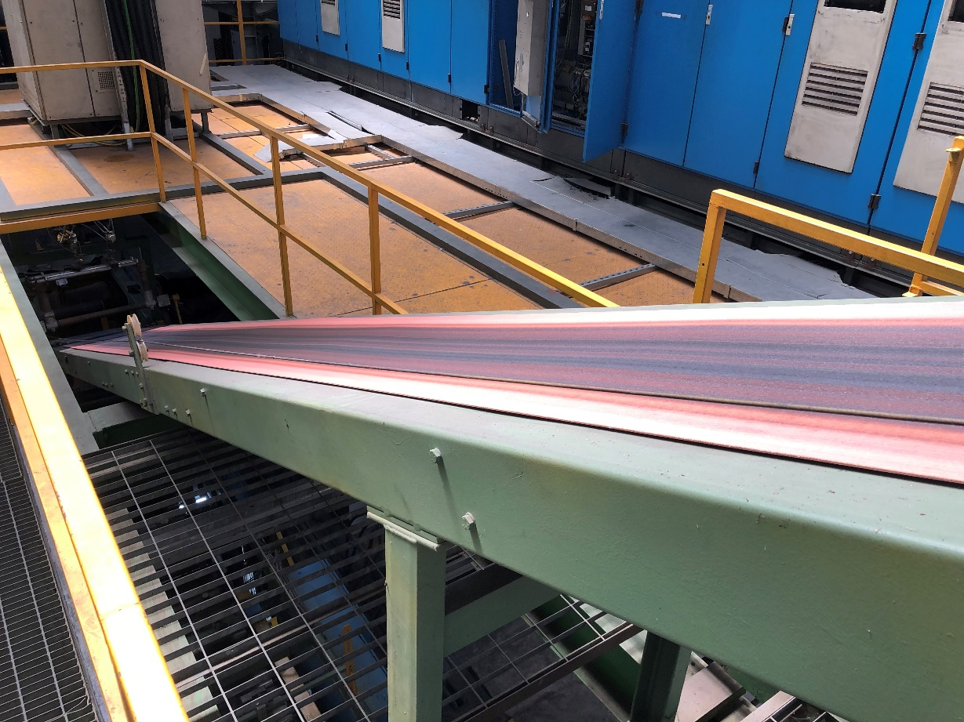
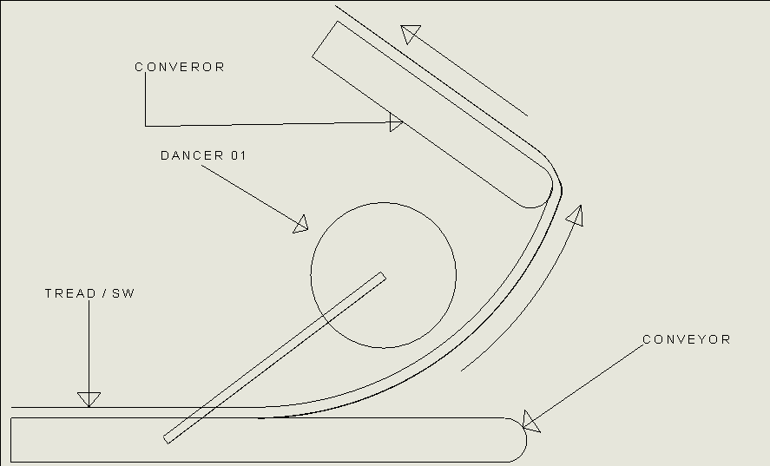
This conveyor is adverting to the tread and side wall production to rise to the cooling line. The width of the conveyor is 600mm. It has 1.1 Kw AC motor.
There is a mechanical weighted element called dancer roll where the located at every conveyor divide place for keep continues production without stretching. If extruded product stretched it will change width and gauge of the production. Therefore, dancer is essential element of the procedure.
Dancer weighted pressure should be set before start the production according to the specification.
There are total 6 dancer rollers in the whole extruder procedure.

Slide 29
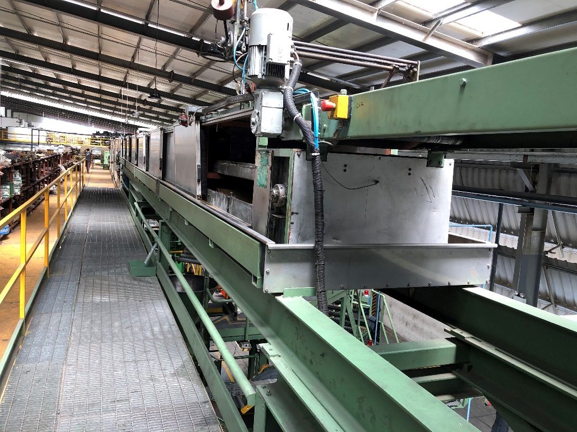
7. Cooling line
Cooling line is important and longest part of the extruder machine. The cooling line is using for removing heat from the extruded product.
Purpose is removing heat and final production temperature should be ambient temperature.
Water is the cooling media of the cooling line; procedure is spraying water on the product and remove heat by using water conductivity.
This water already being cool by chiller unit, that water called chill water.

Slide 30
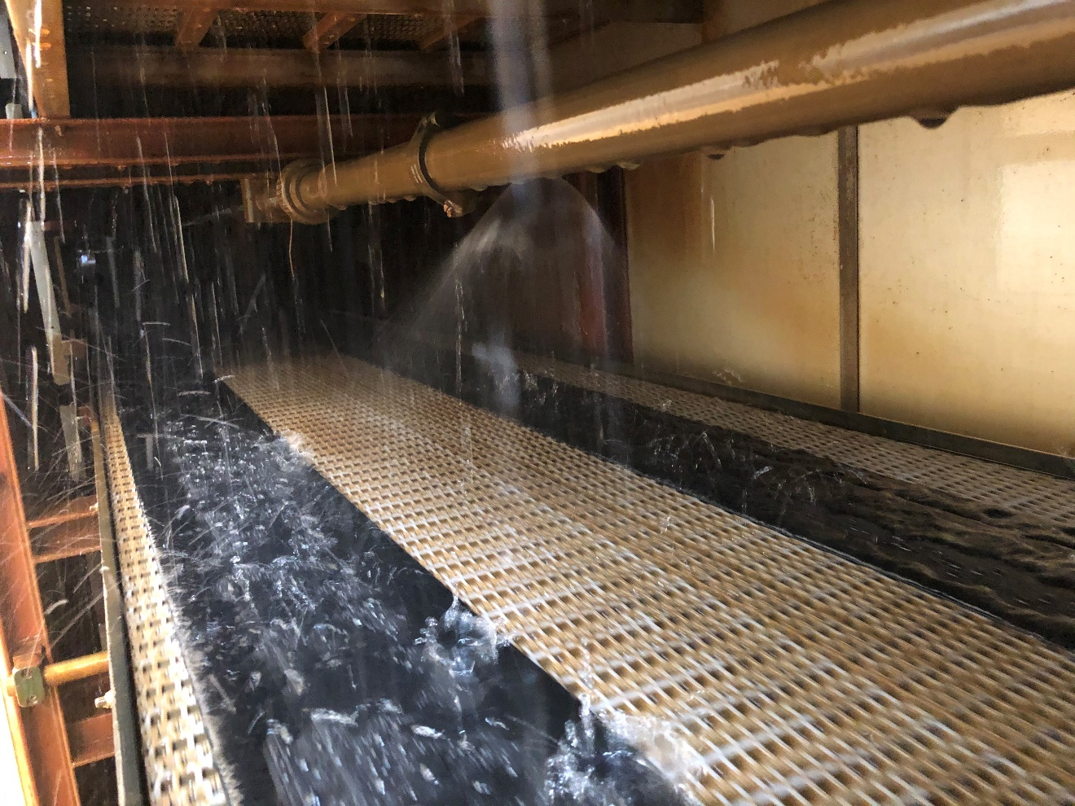
There are 2 cooling conveyors inside the cooling line. This cooling line length almost 70m.
Water circulation pressure is 4bar and width is 600mm.
Each cooling conveyor has 2.2 kW AC motors.
158 nozzles are using for spray water.

Slide 31
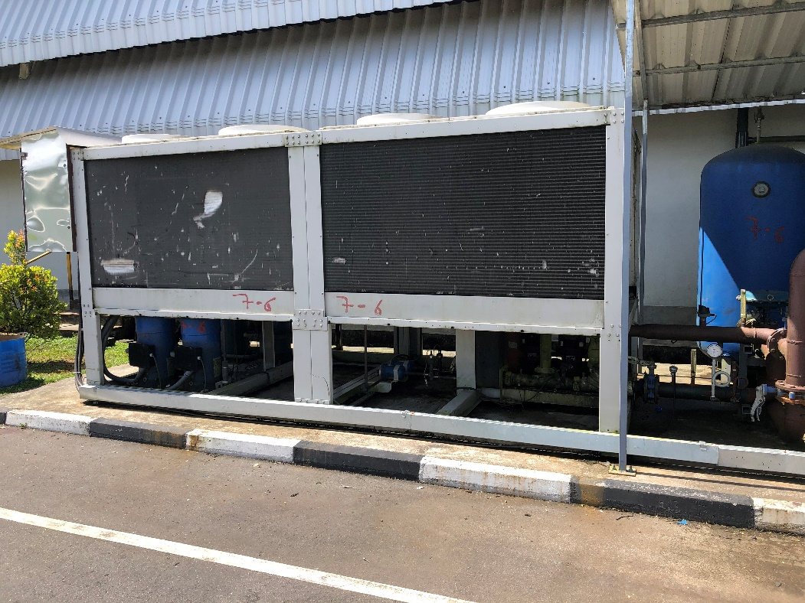
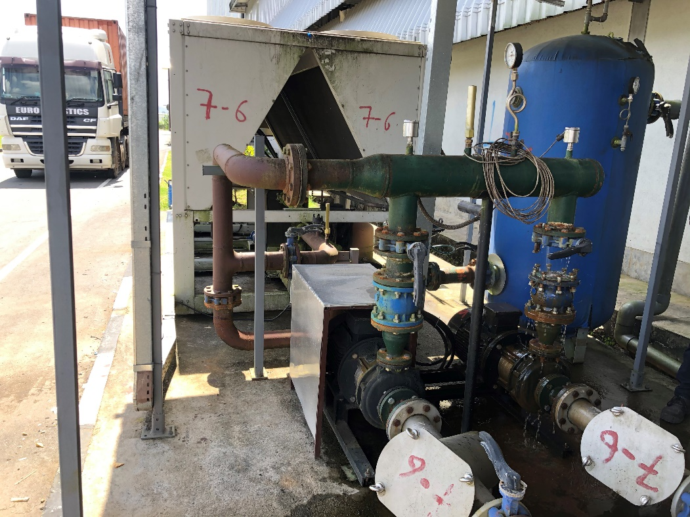
Chilled water system
Chilled water used for cooling media of the cooling line. Water has pressurized to 4 bar of the system.
The temperature range of a chilled water system is 6 to 12 °C with a temperature difference of six degrees. Chilled water is produced by a chiller. The chiller can be seen as the heart of the system, and the chilled water pipes as its arteries.
Heat exchenger
Chiller unit

Slide 32
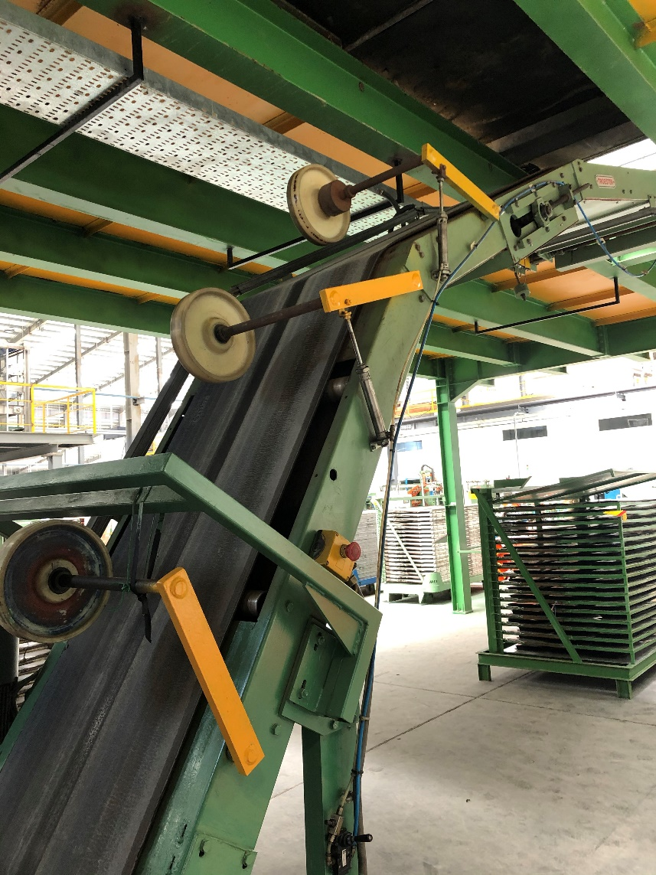







7. Declined Conveyor
Decline conveyor is located at end of the cooling line for bringing down production line to the skiver conveyor.
It has 1.1 kW AC motor. Conveyor width is 600mm.

Slide 33
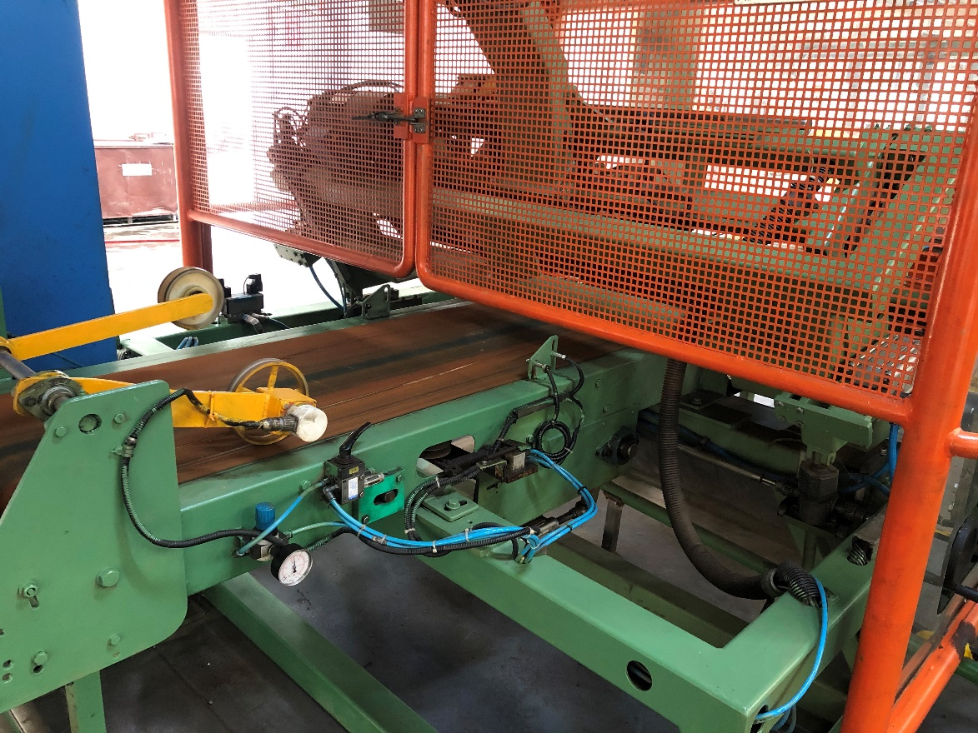



8. Skiver cutter area
Skiver cutter is using for cut the TBB(truck Bus Bias) tyre tread and side walls as their building length.
This cutter blade has specific angle, cutting disc angle is 24˚.
There is electrical component called linear encoder for measuring cutting length of the production.
linear encoder

Slide 34
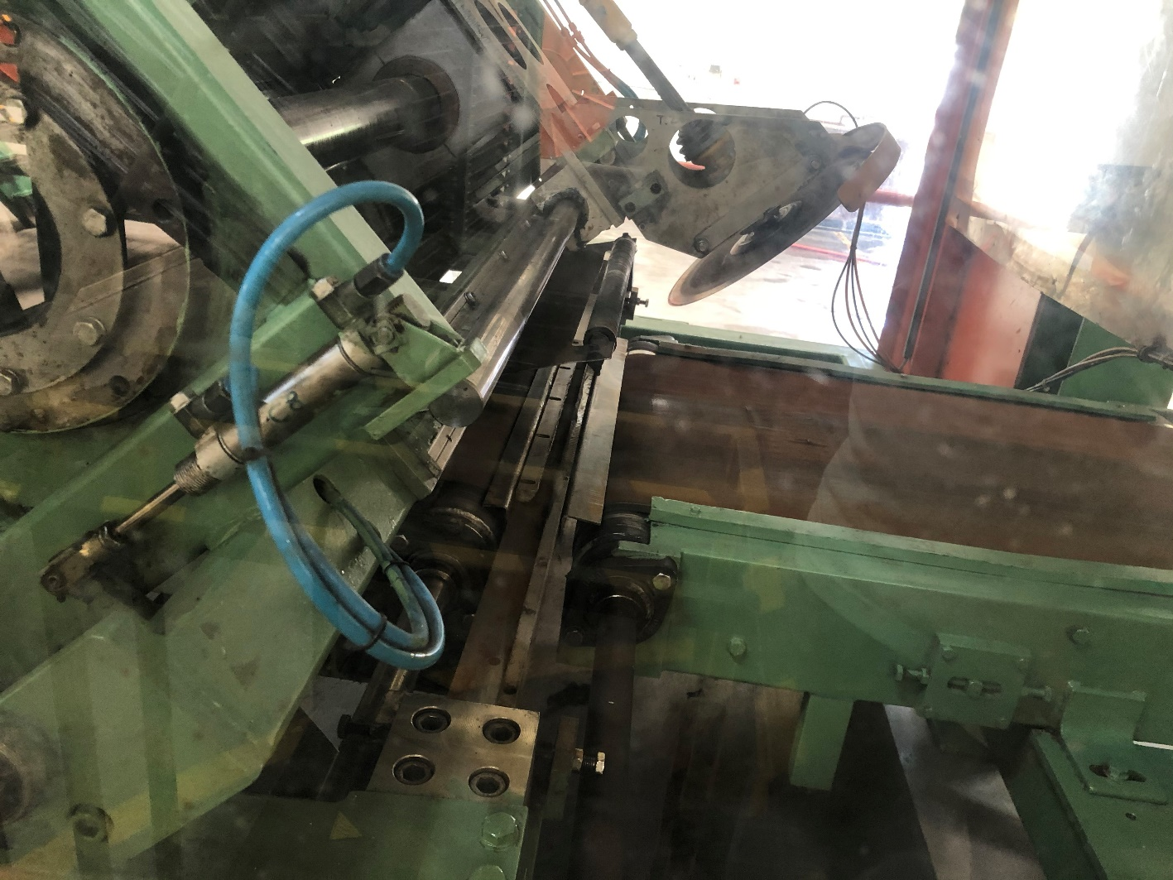
Cutting disk angle- 24˚
Cutter motor capacity-1.5kW AC
Conveyor motor capacity- 1.1kW AC
This cutter vertical move by using pneumatic piston system
linear encoder

